Slide 1
Two Pointers per Node
Recall that our doubly-linked lists require two pointers per DLL_Node:
typedef struct dllnode {
data_t data;
struct dllnode *prev;
struct dllnode *next;
} DLL_node;
Observation: Suppose A_{i} is the address of the i^{th} node in the DLL
We often maintain a pointer p to the i^{th} node
What if we maintained consecutive pointers p and q?
If sizeof(data_t) is the size
of a pointer, that is 3× space!
data_{i}
A_{i−1}
A_{i+1}
data_{i+1}
A_{i}
A_{i+2}
Redundant data
p
A_{i}
q
A_{i+1}

Slide 2
XOR trick!
A new definition of DLL_Node:
typedef struct dllnode {
data_t data;
int xor_PN;
} DLL_node;
To compute A_{i−1}: p->xor_PN ^ q
To compute A_{i+2}: p ^ q->xor_PN
Interview question: How do you do this in Java?
Assuming sizeof(pointer)
= sizeof(int)
O(1) space
overhead!
p
A_{i}
data_{i}
A_{i−1}⊕A_{i+1}
data_{i+1}
A_{i}⊕A_{i+2}
q
A_{i+1}

Slide 3
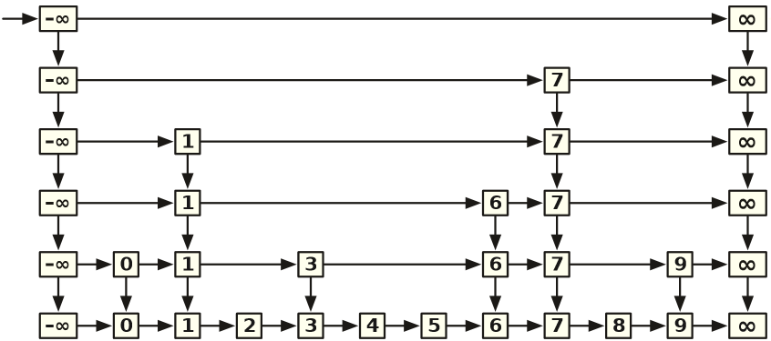
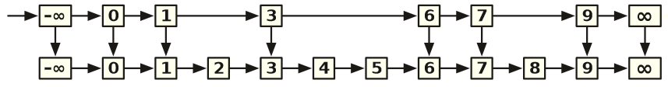
Another clever use: Skip Lists
Suppose we want to maintain a set of integers and support Find, Insert and Delete operations efficiently
Sorted list?
Option 1: ArrayList will do Find in O(log n) time, but Insert/Delete will each take O(n) time
Option 2: LinkedList will require O(n) time in the worst case for all
Option 3: Short-cuts (instead of prev, maintain a down pointer)
Find(5) vs. Find (6)
Worst case for Find?
Now extend this idea recursively!
Worst-case running time: O(n)
Expected worst-case: O(log n)

